Slide 1

Analyzing the Stability of Compact Finite Difference Schemes for Use in Binary Black Hole Simulations
Nathanael Garey¹, Eric Hirschmann¹, David Neilsen¹, James Bleazard¹, Luke Papenfuss¹, Andrew Carroll¹
¹Brigham Young University, Provo, UT 84602
Undergraduate Presentation

Slide 2
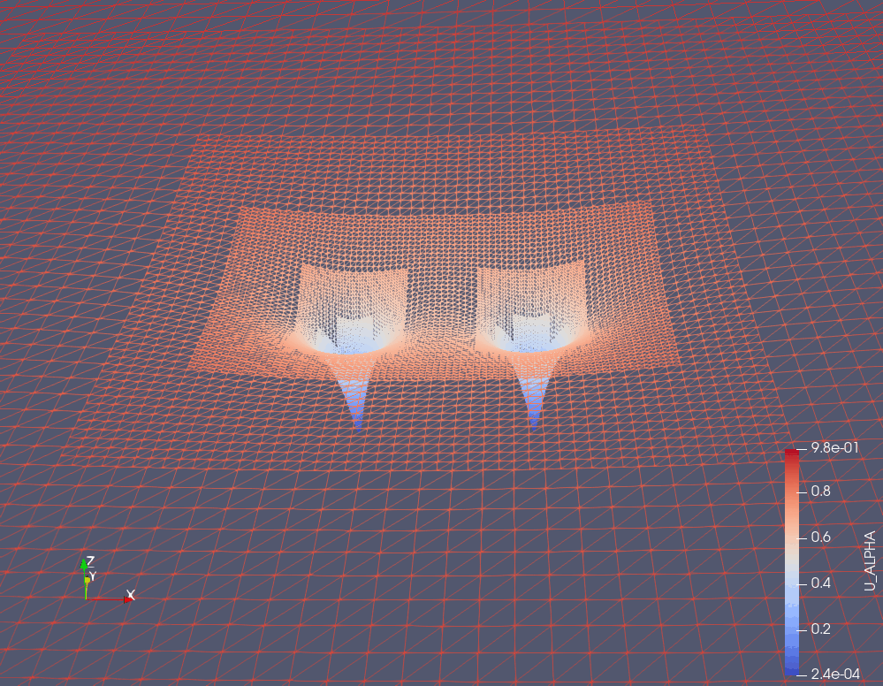
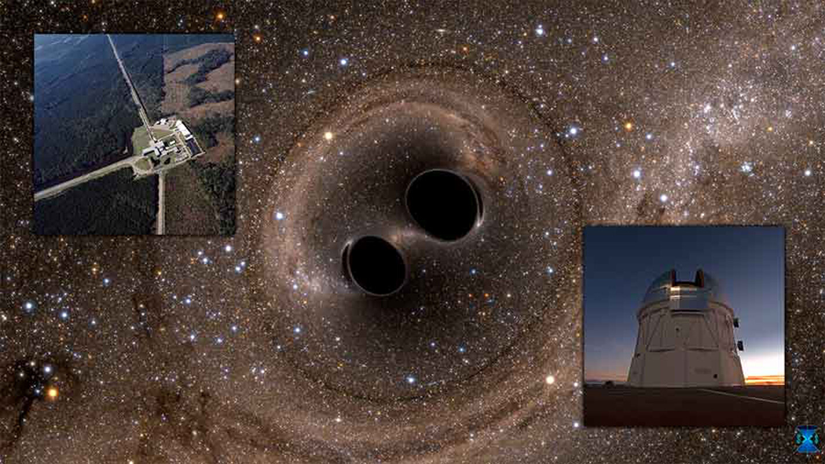
Purpose/Goals
Fast and accurate black hole mergers are needed
Additional factors (high mass ratio, spin, eccentricity) increase computational costs
Important with new/improved gravitational wave detectors
https://commons.wikimedia.org/wiki/File:Gravitational_waves_detected_100_years_after_Einstein%E2%80%99s_prediction_%28noaoann16005a%29.jpg
Notes:
Want to model GW faster and with high accuracy
Important/relevant with new projects like LISA
Difficult challenge to employ methods that improve accuracy but are stable

Slide 3
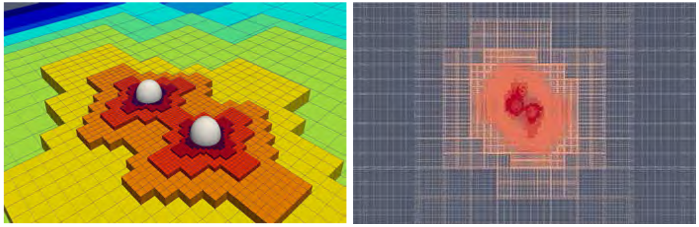
Dendro-GR
Binary black hole simulations with Wavelet Adaptive Mesh Refinement (WAMR)
Less refinement needed in the grid where information hasn’t propagated
We will implement our methods with hope to improve accuracy and communication
Massively Parallel Simulations of Binary Black Hole Intermediate-Mass-Ratio Inspirals (Fernando et al., 2019)
Notes:
The codebase that runs binary merger simulations
WAMR saves on computational time
When we find the stable schemes, we will implement them into Dendro
Hope to improve accuracy and communication – WAMR has smaller stencil sizes so we could potentially reduce communication costs between different “subgrids”

Slide 4
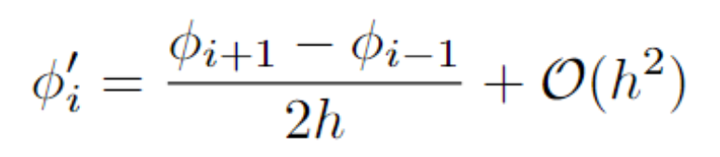
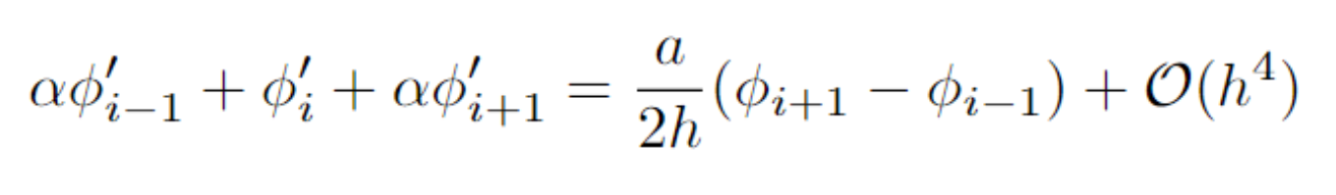
Explicit vs. Compact Schemes
Centered explicit scheme comes from the limit definition of the derivative
Compact Finite Difference (CFD) schemes can achieve higher accuracy with less points
The matrix inversion is an additional computational cost that can be reduced
Our current effort is to find stable compact schemes
Explicit Scheme
Implicit/Compact Scheme
Notes:
CFD comes with additional difficulties that we are addressing (matrix inversion, harder to find stability)
There are fast methods to invert banded matrices
We also only must invert the matrix a few times on smaller grid sizes
The improvement from using less points is worth introducing the additional complications

Slide 5
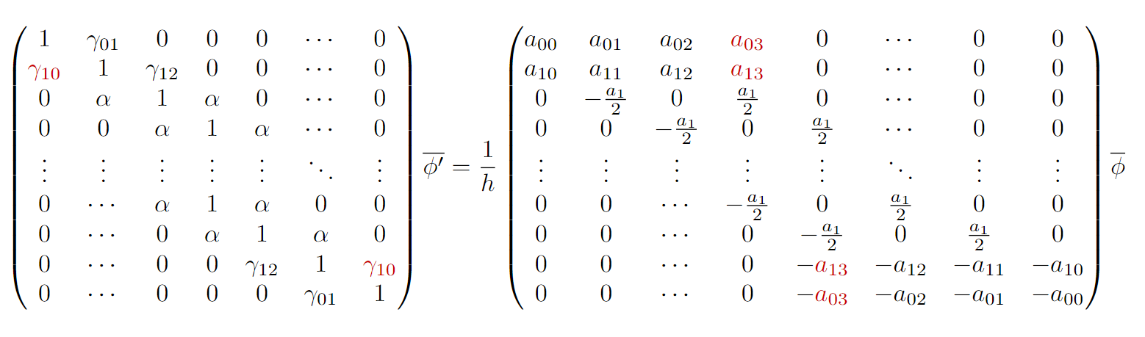
Improving Stability
Start with a CFD with Dirichlet boundary conditions
Add free parameters that can vary from their “original” value
Run many tests with different free parameters and eliminate options that become unstable
Notes:
Brady and Livescu did this for 1st derivatives, our goal is to do this for 2nd derivatives as well
To choose free parameters, we increase the stencil size beyond “what is needed” for a certain order of accuracy; we then can have more variables than constraint equations, so some are free
Free parameters can be optimized algorithmically to find choices that lead to stability or optimize accuracy

Slide 6
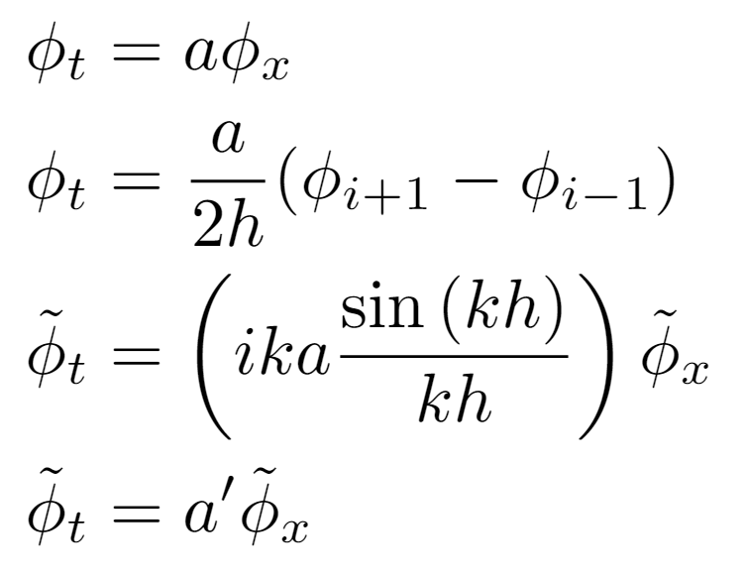
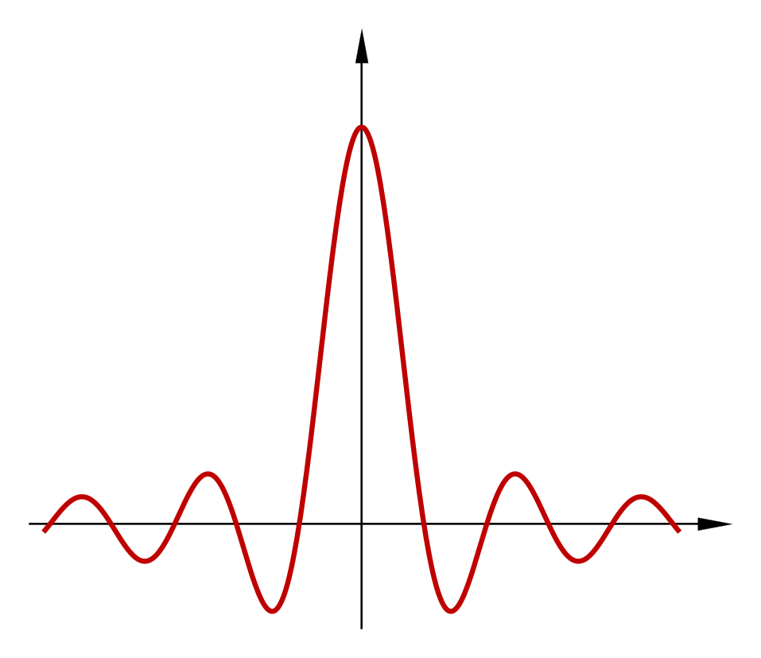
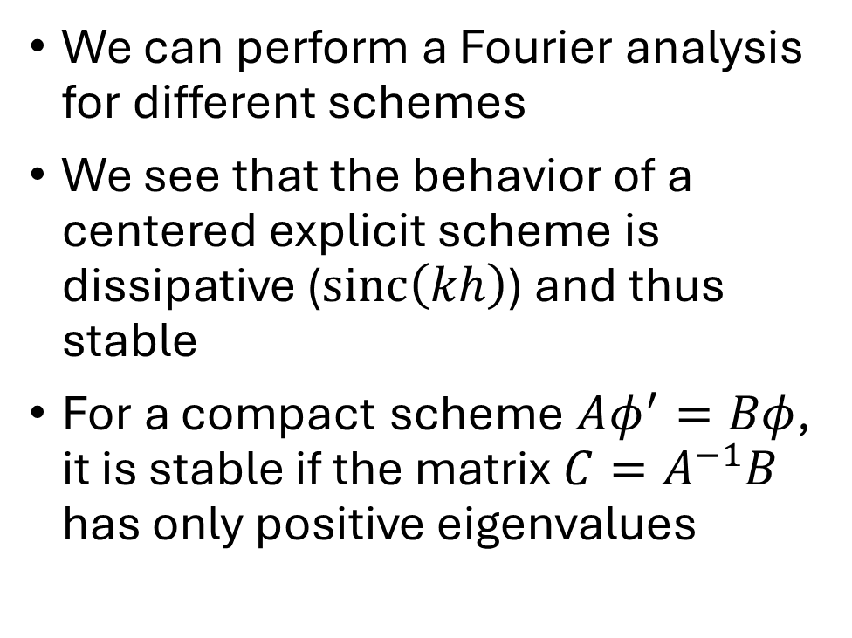
Analytic Approach
We can perform a Fourier analysis for different schemes
We see that the behavior of a centered explicit scheme is dissipative ($sinc\left(kh\right)$) and thus stable
For a compact scheme $Aφ^{′}=Bφ$, it is stable if the matrix $C=A^{−1}B$ has only positive eigenvalues
https://upload.wikimedia.org/wikipedia/commons/2/26/Sinx_x.png

Slide 7
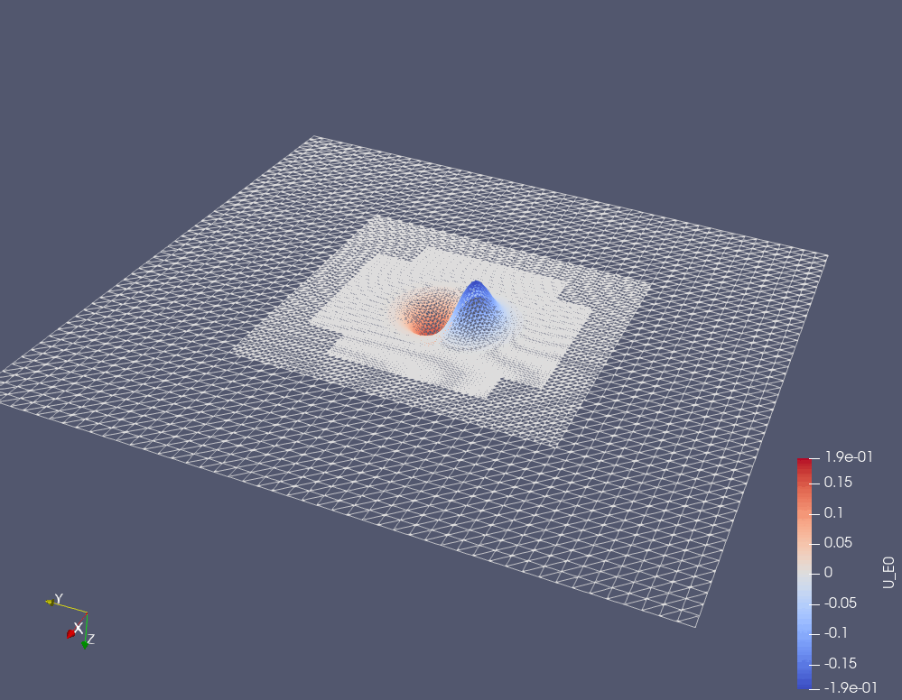
Unoptimized Scheme with Instability
Notes:
This is a time evolution of Maxwell’s equations with a CFD operator that hasn’t been optimized for stability

Slide 8
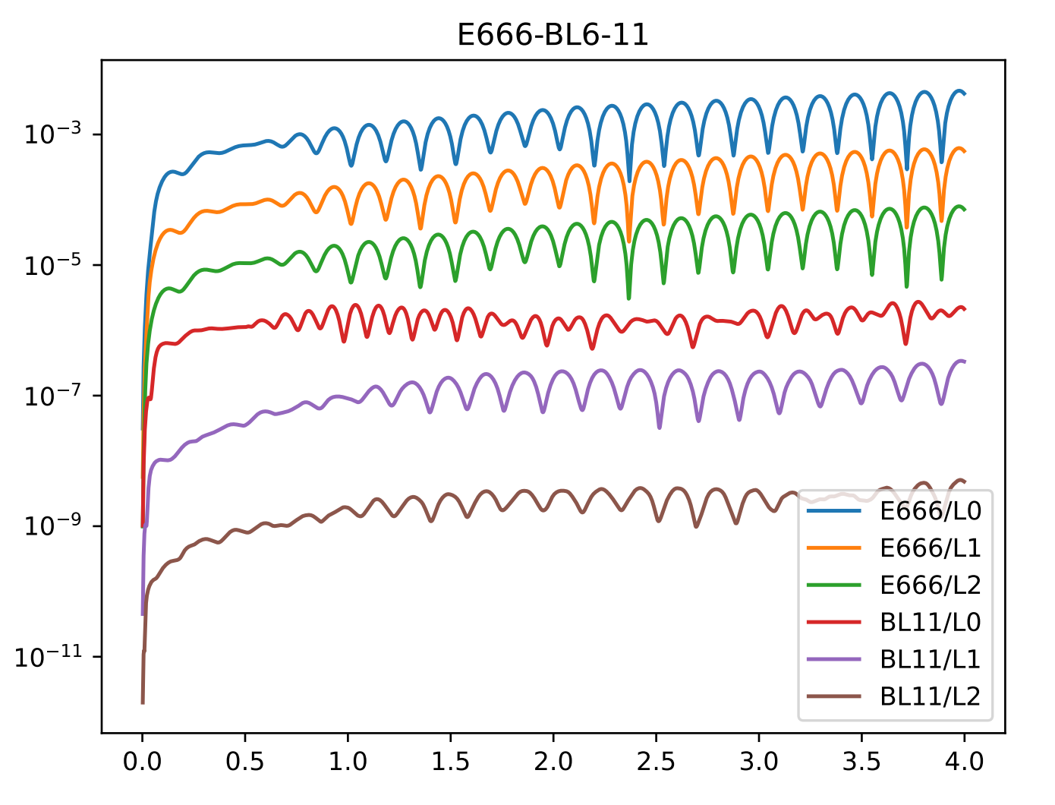
Time Evolution of Stable Schemes
Notes:
This shows the error for another Maxwell equation time evolution
E666 is Explicit 6th order in all 3 spatial dimensions
L0/L1/L2 is different levels of refinements (more grid points)
BL11 is a stable Brady and Livescu compact scheme; stability is shown by lack of blowing up but they also achieve much higher accuracy, being compact schemes

Slide 9
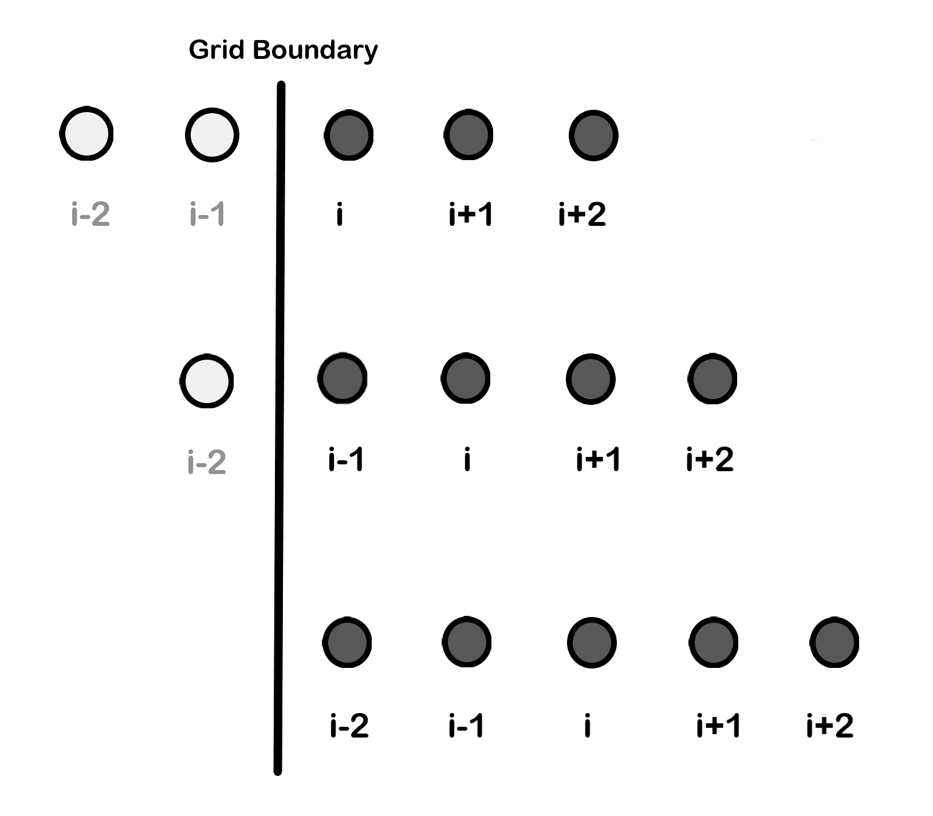
Improving Accuracy
Boundary points have worse accuracy than interiors
Centered vs. shifted stencils – less points to approximate the function’s derivative
Interpolation function allows boundary points to use information from “points” outside the scheme, acting like a centered stencil
Notes:
Kim approach – interpolation function to almost treat boundaries as centered stencils
Convey what this means a little better

Slide 10
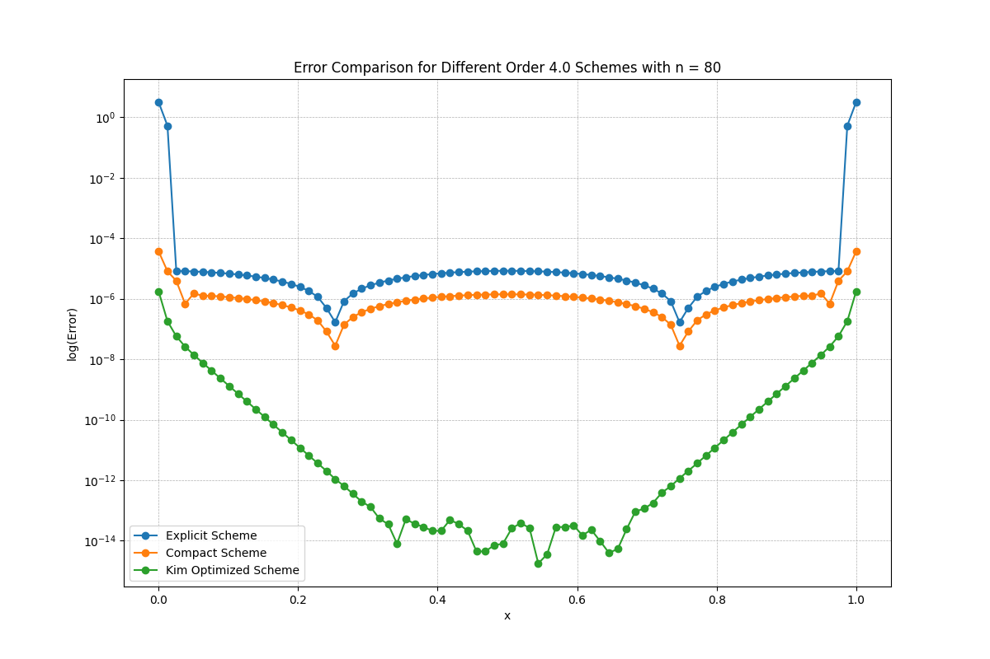
Towards a genuinely stable boundary closure for pentadiagonal compact finite difference schemes (Kim et al., 2024)
Notes:
This is a direct measure of the error at different spatial points on the grid (error = analytic – numerical)
Kim boundaries are about 10x better and the interior is too; the shape is “flatter”

Slide 11
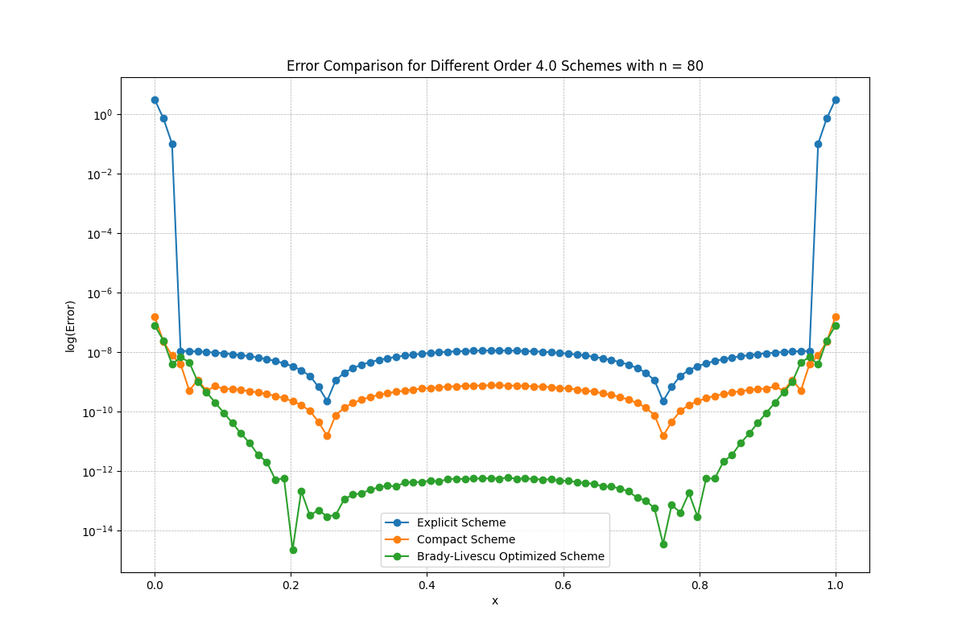
High-order, stable, and conservative boundary schemes for central and compact finite differences (Brady and Livescu, 2018)
Notes:
BL boundaries aren’t as optimized, but the scheme has stability

Slide 12
Future Work
Run machine learning optimization algorithm to find parameters for stable CFD schemes
Continue analytic work to show that schemes are stable and discover where instabilities arise
Implement boundary interpolation methods to improve accuracy on boundary points

Slide 13
Acknowledgements
I would like to thank Dr. Eric Hirschmann, Dr. David Neilsen, and Dr. William Black for their mentorship and help with my research efforts.
We would like to thank the National Science Foundation (NSF-PHY 2207615) and Brigham Young University for their funding in support of our research efforts.
Notes:
Acknowledgements – who else has worked on it, credit to NSF (grant #) and BYU for support
Mention James’s poster later on
NSF-PHY 2207615

